Slide 1

Management Topic in Environmental Studies)
B. Tech 7TH Semester
Mineral Resources
Unit 2
Natural Resources
Department: Chemistry
Subject: MTES (CHM2049)

Slide 2
Contents
Introduction to Mineral resources
Classification of minerals
Uses and exploitation of mineral resources
Major reserves and important uses of some of the major metals
Major Minerals of India
Environmental impacts of mineral extraction and use
Major mines causing severe Environmental problems
Impacts of mining
Remedial measures
Notes:
2

Slide 3
Introduction
Minerals are naturally occurring, inorganic, crystalline solids having a definite chemical composition and characteristic physical properties.
Critical minerals: are essential for the economy of a nation
e.g. iron, aluminium, copper, gold etc.
Strategic minerals: required for the defence of a country e.g. Uranium, Manganese, cobalt, platinum, chromium Vanadium, tungsten, molybdenum, cobalt etc.

Slide 4
Uses and exploitation
The main uses of minerals are as follows:
(i) Development of industrial plants and machinery.
(ii) Energy Source: coal, lignite, uranium.
(iii) Construction, housing, settlements.: Iron,
(iv) Defence equipments-weapons, armaments.
(v) Transportation means.; Rail, Vehicle
(vi) Communication- telephone wires, cables, electronic devices.
(vii) Medicinal system- Ayurvedic/Allopathic System: Ag, Au,Zn
(viii) Formation of alloys for various purposes (e.g., Bronze, Brass).
(ix) Agriculture: fertilizers, seed dressings and fungicides (e.g.
zineb containing zinc, Maneb-containing manganese etc.).
(x) Jewellery: Gold, silver, platinum, diamond.

Slide 6
Major uses of some non-metalic minerals
Maximum quantity used: Iron and steel (740 million metric tons annually)
followed by manganese, copper, chromium, aluminium and Nickel.

Slide 7
Major reserves and important uses metals
Major world reserves of most of the metallic minerals are:
USSR, USA, Canada, South Africa and Australia
Japan virtually no metal reserves
Notes:
CIS
m

Slide 8
Major Minerals of India
(a) Energy generating minerals: Coal and lignite: West Bengal, Jharkhand, Orissa, M.P., A.P.
Uranium (Pitchblende or Uranite ore): Jharkhand, Andhra Pradesh (Nellore, Nalgonda), Meghalaya, Rajasthan (Ajmer).
(b) Other commercially used minerals Aluminium (Bauxite ore): Jharkhand, West Bengal, Maharashtra, M.P., Tamilnadu.
Iron (haematite and magnetite ore): Jharkhand, Orissa, M.P., A.P., Tamilnadu, Karnataka, Maharashtra and Goa.
Copper (Copper Pyrites): Rajasthan (Khetri), Bihar, Jharkhand, Karnataka, M.P., West Bengal, Andhra Pradesh and Uttarnchal.
India is the producer of 84 minerals the annual value of which is about Rs. 50,000 crore

Slide 9
State wise share of minerals Production in India

Slide 10
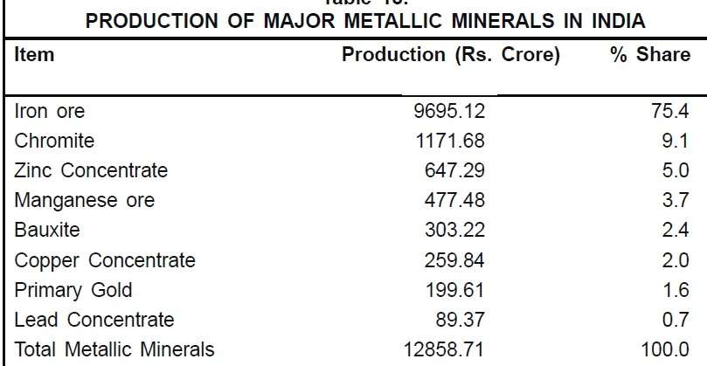
Production of major metallic minerals in India
Mineral Reserves in Odisha
Odisha is the hub of minerals
resource in India
Notes:
PYROPHYLLITE:Pyrophyllite is a phyllosilicate mineral composed of aluminium silicate hydroxide:

Slide 11
Major mines causing severe Environmental problems
i) Jaduguda Uranium Mine: , Jharkhand.exposing local people to radioactive hazards.
(ii) Jharia coal mines: Jharkhand.underground fire leading to land subsidence and forced displacement of people.
(iii) Sukinda chromite mines, Orissa. seeping of hexavalent chromium into river posing serious health hazard, Cr⁶⁺ being highly toxic and carcinogenic.
(iv) Kudremukh iron ore mine, Karnataka.causing river pollution and threat to biodiversity.
(v) East coast Bauxite mine, Orissa.Land encroachment and issue of rehabilitation unsettled.
(vi) North-Eastern Coal Fields: Assam.Very high sulphur contamination of groundwater.

Slide 12
Impacts of mining:
(i) Devegetation and defacing of landscape: The topsoil as well as the vegetation are removed deforestation leads to several ecological losses, increase the landscape. prone to soil erosion.
(ii) Subsidence of land: Mainly associated with underground mining.
results in tilting of buildings,
cracks in houses,
buckling of roads, sudden change in structure
bending of rail tracks and
leaking of gas from cracked pipelines leading to serious disasters.
(iii) Groundwater contamination: pollutes the groundwater
Sulphur containing ore converted into sulphuric acid through microbial action, thereby making the water acidic which enhances toxic metal leaching posing health hazards.
Notes:
BUCKLING

Slide 13
Impacts of mining:
(iv) Surface water pollution: The acid mine drainage often contaminates the nearby streams and lakes.
Sometimes uranium, Cr, Pb, Cd, As contamination by mine wastes kill aquatic animals and creating human health hazards.
(v) Air pollution: Ore, smelting emits air pollutants damaging the vegetation and serious environmental damage and human health hazard .
The suspended particulate matter (SPM),
SOx, soot, arsenic particles,
cadmium, lead etc.
Notes:
SHOOT

Slide 14
Occupational Health Hazards
Most of the mining worker suffer
Respiratory and skin diseases due to constant exposure to the suspended particulate matter and toxic substances.
Suffer by Asbestosis, silicosis, black lung disease etc.
Statistical data: , on an average, there are 30 non-fatal but disabling accidents per every ton of mineral produced
one death per 2.5 tons of mineral produced.
Remedial measures:
i) Adopt eco-friendly mining technology: Microbial-leaching technique
Thiobacillus ferroxidans used for extracting gold embedded in iron sulphide ore
it remove sulphur from ore

Slide 15
Remedial measures
ii) Restoration of mined areas by re-vegetating: them with appropriate plant species, stabilization of the mined lands, gradual restoration of flora,
iii) prevention of toxic drainage discharge and need suitable treatment.
iv) Controlling the standards of air emissions are essential for minimizing environmental impacts of mining.

Slide 16
Thank You All

